Slide 1
Design Specification
By: Team 4D

Slide 2
Team 4D - Car Website
The aim of our website is to give sellers a market to sell their cars for the right prices and so the users can interact with such sellers and find their best budget car or dream car.
The user can be a buyer if they choose to. But to be a seller the user must create an account.The user can search for cars and use the filter bar to filter for specific cars. The user can also upload and sell cars. The user can also post reviews on specific cars.If a user wants to buy a car, they can message the seller, however they have a account before the user can proceed as such.
Each car has its own specific details and reviews. Each car can also be specified by brand, quality of use and more. This will provide more details for users to carefully pick cars.

Slide 3
Requirements

Slide 4
Persona One

Slide 5
Persona Two

Slide 6
System Architecture

Slide 7
Site Map

Slide 8
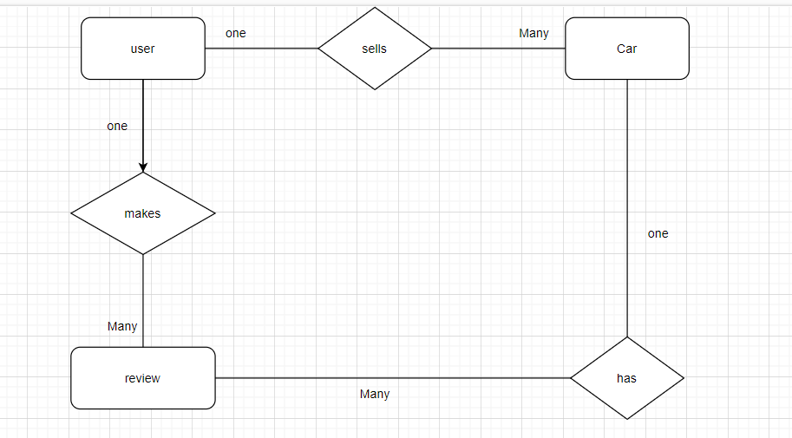
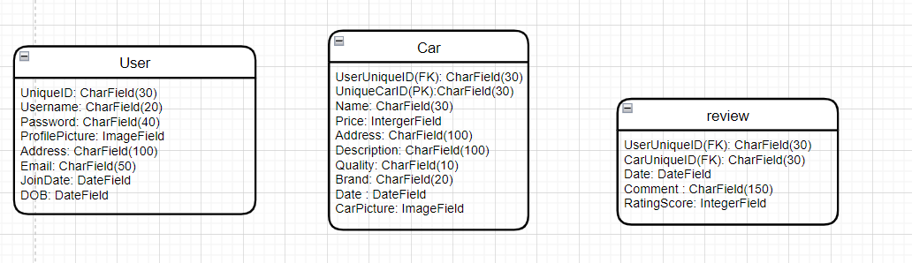
ER diagram

Slide 9
URLS
-/Home
-/Home/Cars
-/Home/Cars/New/
- /Home/Cars/Used/
-/Home/Sell-Cars
-/Home/Sell-Cars/Car-Upload
-/Home/Electric
-/Home/Cars/Car-Details
-/Home/Cars/Car-Brand
-/Home/Login
-/Home/Register
-/Home/Contact-Us

Slide 10
URLS continued
-/Home/About-Us
-/Home/Saved
-/Home/MyAccount
-/Home/Message-Seller

Slide 11
Wireframes

